Slide 1

Parkinson Disease Detection Using Handwriting
Project Presentation
By
MITU19BCTS0210 Chaitanya Patil
MITU19BCTS0111 Sarthak Hatwar
MITU19BTCS0093 Satyam Fofandi
MITU19BTCS0250 Eleen Shah
Guided By
Dr .Nilima Kulkarni
Department of Computer Science & Engineering, MITSoE, Loni Kalbhor

Slide 2
Outline
1. INTRODUCTION
2. MOTIVATION
3. LITERATURE SURVEY
4. RESEARCH GAP
5. PROBLEM STATEMENT
6. OBJECTIVES
7. METHODOLOGY
8. DATASET
9. Model Outputs
10. Refrences
Department of Computer Science & Engineering, MITSoE, Loni Kalbhor

Slide 3
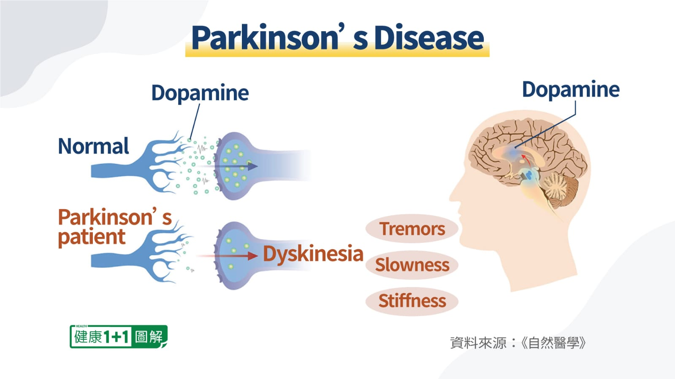
1. Introduction
Parkinson’s Disease (PD) is the second most common neurodegenerative disorder after Alzheimer’s disease.
PD cannot be cured but its progression can be delayed by management of symptoms.
The symptoms of PD arise from decreasing levels of the chemical messenger dopamine.
People with PD have difficulty controlling body movements due to changes in neuronal mechanisms. Hence, handwriting changes can be an early indicator of PD.
Department of Computer Science & Engineering, MITSoE, Loni Kalbhor

Slide 4
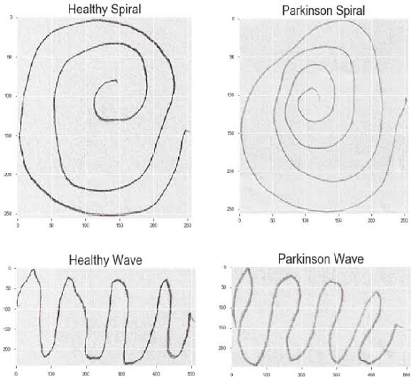
1. Introduction
In the early stages of the disease, changes in handwriting are small and barely noticeable. Thus, it is important to detect such small changes in writing patterns as they can signal the presence of subclinical PD.
Handwriting analysis could provide a cheap and non-invasive tool for supporting the early diagnosis of the disease and a method for the evaluation of the disease progression.
Department of Computer Science & Engineering, MITSoE, Loni Kalbhor

Slide 5
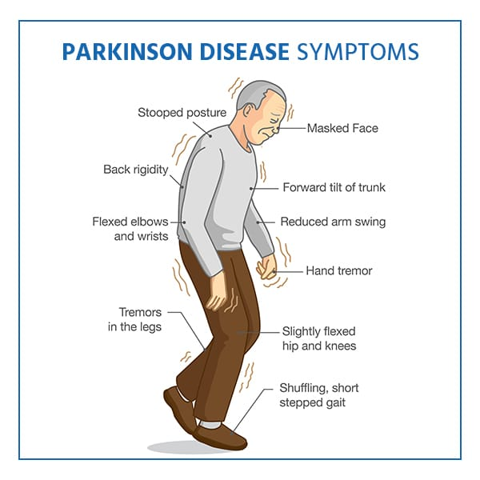
2. Motivation
Early diagnosis would provide more effective and prompt care strategies, that could successfully influence patients’ life expectancy.
The etiology of Parkinsons disease (PD) remains unclear.
Diagnosis of Parkinson’s disease (PD) is often based on medical attention and clinical signs.
Department of Computer Science & Engineering, MITSoE, Loni Kalbhor

Slide 6
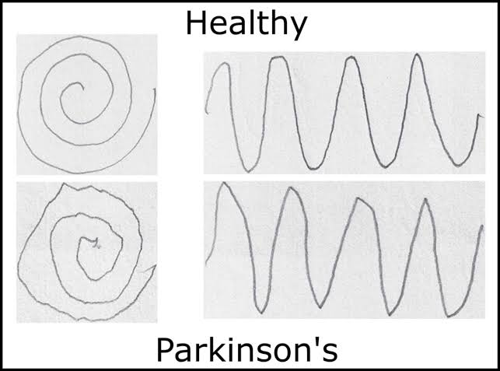
2. Motivation
In India, approximately one million cases have had similar experiences for symptoms of PD.
Besides these challenges, the pharmaceutical industry has been slow in producing PD drugs. The last invention in this area was in 1967.
Department of Computer Science & Engineering, MITSoE, Loni Kalbhor
Notes:
In the last decades, early disease identification through non-invasive and automatic methodologies has gathered increasing interest from the scientific community. Among others, Parkinson’s Disease (PD) has received special attention in that it is a severe and progressive neuro-degenerative disease. As a consequence, early diagnosis would provide more effective and prompt care strategies, that colud successfully influence patients’ life expectancy.
Symptoms usually appear after approximately 70% of dopamine-producing cells have stopped working normally. The etiology of Parkinsons disease (PD) remains unclear.
Diagnosis of Parkinson’s disease (PD) is often based on medical attention and clinical signs. It is subjective and does not have a good prognosis. Artificial Intelligence (AI) has played a promising role in the diagnosis of PD.

Slide 7
3. Literature Survey
Sr. No | Paper | Remarks | Limitations
1. | Handwriting Dynamics Assessment Using Deep Neural Network for Early Identification of Parkinsons Disease | increased the input space by combining different PD handwritten datasets applied various data augmentation techniques | No interpretability
2. | Sequence-based Dynamic handwriting analysis for Parkinson’s disease detection with one-dimensional convolutions and BiGRUs | dynamic features of handwriting are fed as input to the RNN model | Difficult to get dynamic features of handwriting
3. | Cartesian Genetic Programming for Diagnosis of Parkinson Disease through Handwriting Analysis: performance vs. interpretability issue | Decision rules produced by CGP and DT are in accordance with medical findings. Rather than providing accuracy , it also offers a degree of interpretability. | Biased model because input data is less
4. | Digitized spiral drawing classification for Parkinson’s disease diagnosis | four ML models are implemented on mathematically processed dataset. | Can’t be applied to spiral drawings
Department of Computer Science & Engineering, MITSoE, Loni Kalbhor

Slide 8
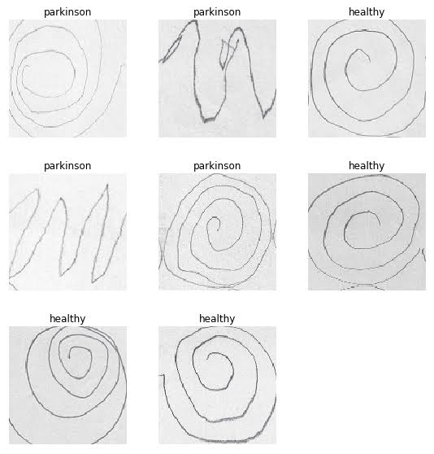
4. Research Gap
Due to the high variability of PD symptoms and progression of motor symptoms, and the lack of adequate quantities of data, both traditional machine learning methods and deep learning approaches have displayed poor performance for early identification of PD. To overcome such challenges, we will combine all the datasets to increase the training set size for deep neural networks.
Department of Computer Science & Engineering, MITSoE, Loni Kalbhor
Notes:
each person with PD will have different symptoms, disease progression, lifestyle effects, and physical tolerances, i.e. no two people with PD will experience the condition in the same way.

Slide 9
5. Problem statement
To create a deep learning model for early diagnosis of Parkinson Disease(PD) through handwriting samples from both healthy people and PD affected people.
Department of Computer Science & Engineering, MITSoE, Loni Kalbhor

Slide 10
6. Objectives
To understand the important features involved like Kinematic pressure , stroke pressure , spiral radius, spiral speed ,etc.
To find out how much a feature is impacting the output by calculating co-relation.
To find suitable data pre-processing technique so as to improve performance.
To incorporate different PD datasets and study them.
To create a suitable deep learning architecture for each dataset.
Department of Computer Science & Engineering, MITSoE, Loni Kalbhor

Slide 11
7. Methodology
Input- 648 images
Data Preprocessing
Deep Learning
-PD Dataset
-Add noise
-CNN
Testing
New Input
Final Prediction
LSTM
Department of Computer Science & Engineering, MITSoE, Loni Kalbhor

Slide 12
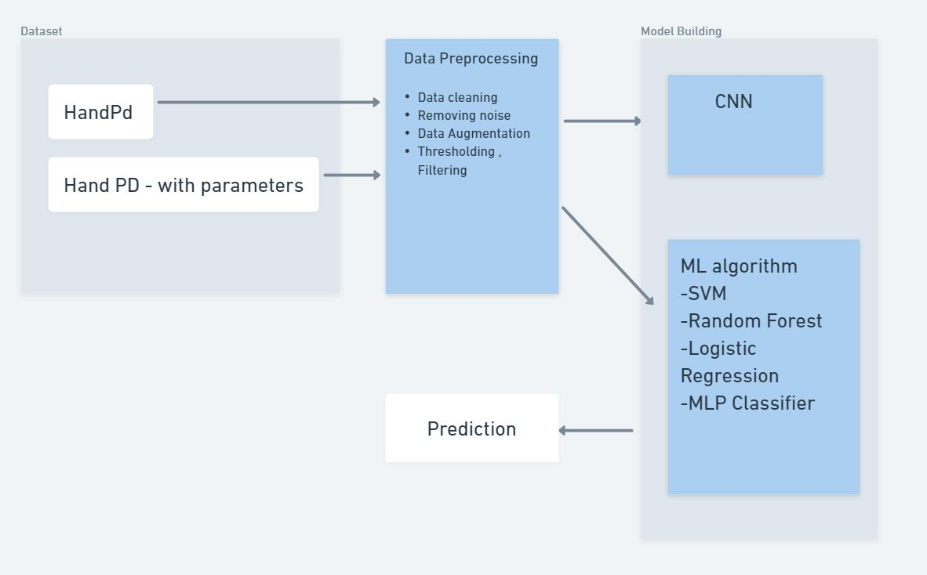
7. Methodology
Department of Computer Science & Engineering, MITSoE, Loni Kalbhor

Slide 13
8. Datasets
Dataset that we are going to use is Parkinson’s Drawing Dataset.
It contains 72 images of each class for training and 30 images of each
class for testing.
Image size is 256 X 256 X 3.
This dataset contains images of spiral drawn by both healthy persons and
the patients suffering from Parkinson’s
Department of Computer Science & Engineering, MITSOE, Loni Kalbhor

Slide 14
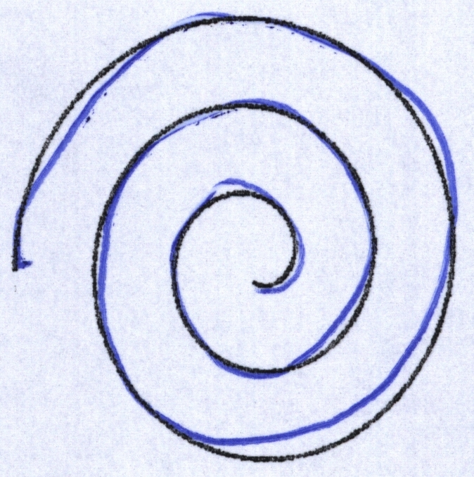
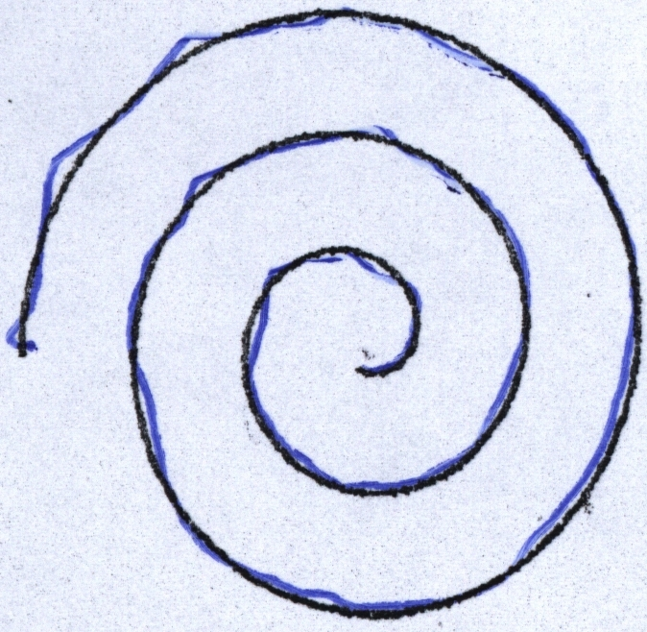
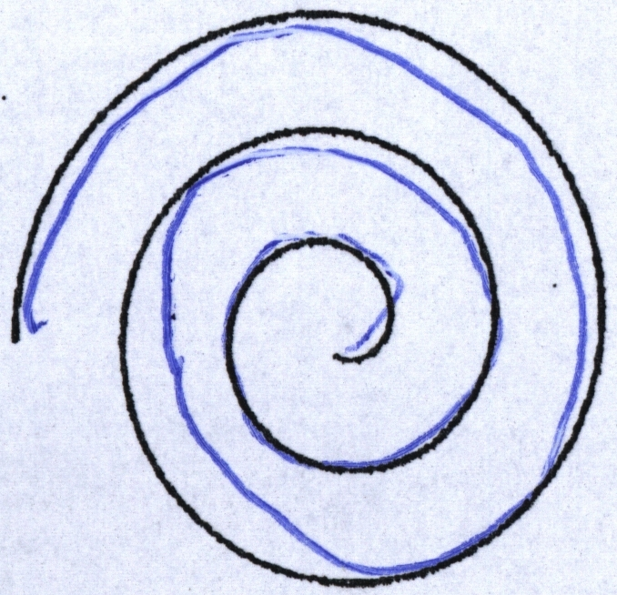
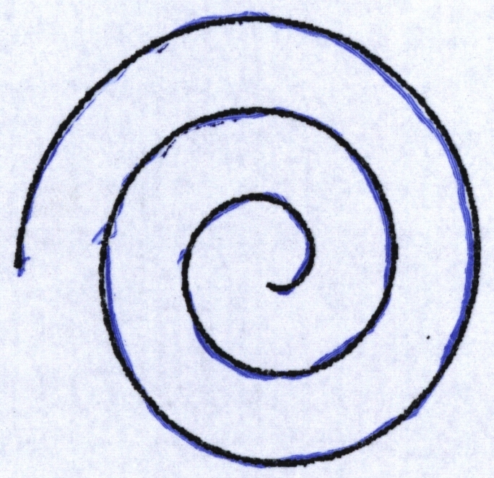
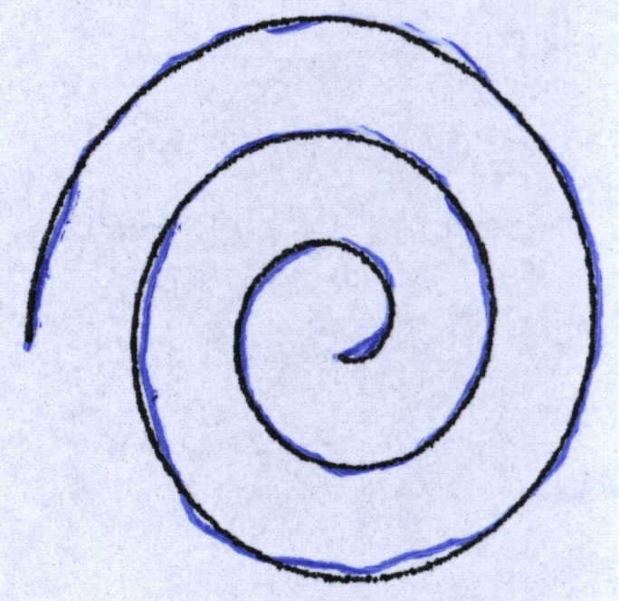
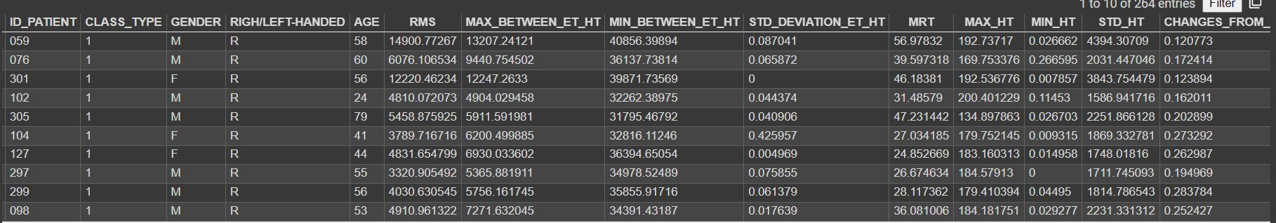
8. Dataset
Sp1-h1
Sp2-h1
Sp1-h2
Sp2-h2
Sp3-h3
Spiral Images from each patient
Department of Computer Science & Engineering, MITSoE, Loni Kalbhor

Slide 15
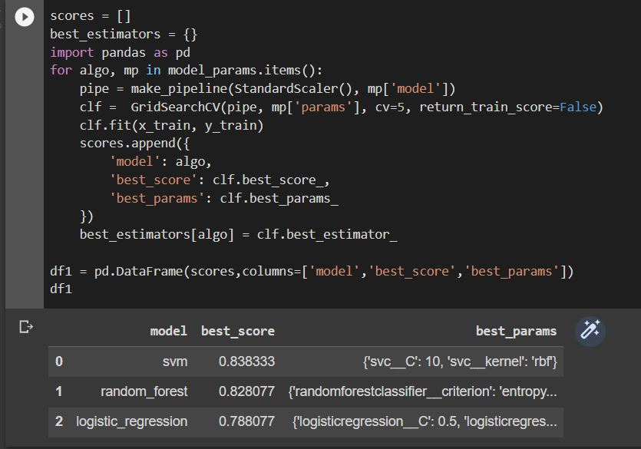
9. Model – ML model
Department of Computer Science & Engineering, MITSoE, Loni Kalbhor

Slide 16
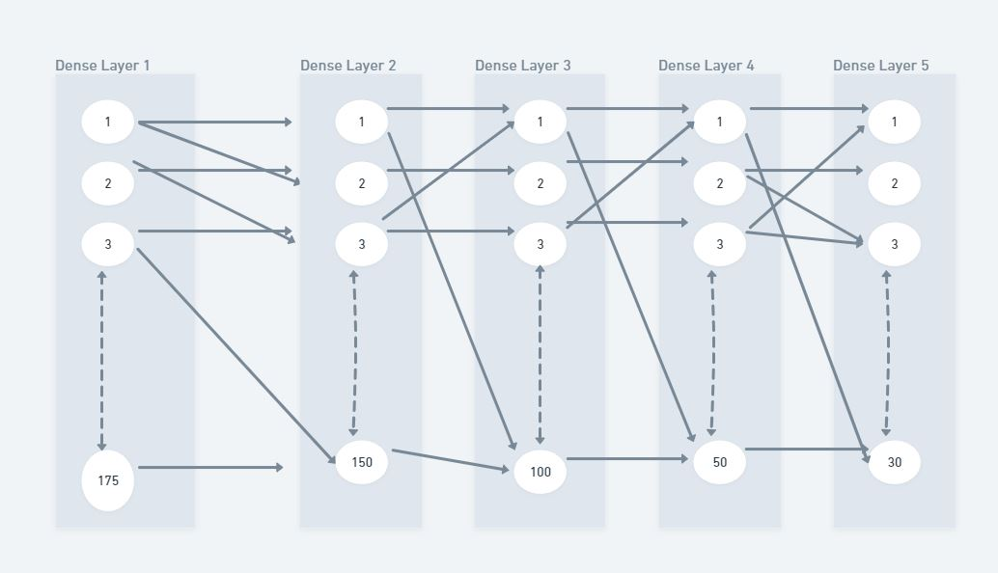
9. Model – Deep Learning
Department of Computer Science & Engineering, MITSoE, Loni Kalbhor

Slide 17
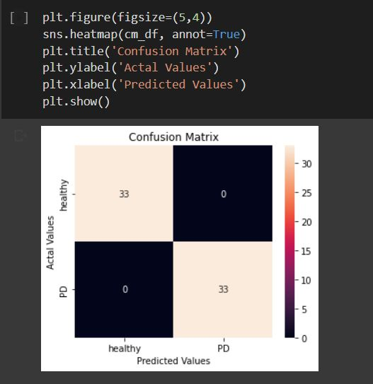
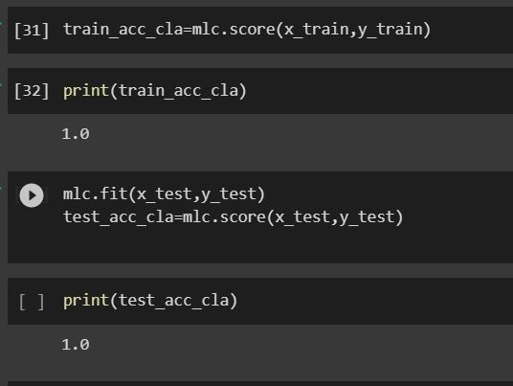
9. Model – Deep Learning
Department of Computer Science & Engineering, MITSoE, Loni Kalbhor

Slide 18
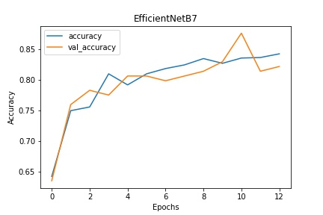
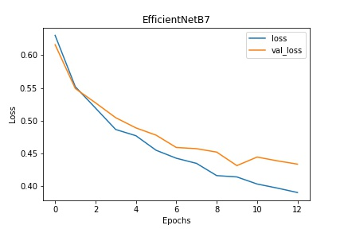
9. Model – CNN
Accuracy
87 %
Loss
Department of Computer Science & Engineering, MITSoE, Loni Kalbhor

Slide 19
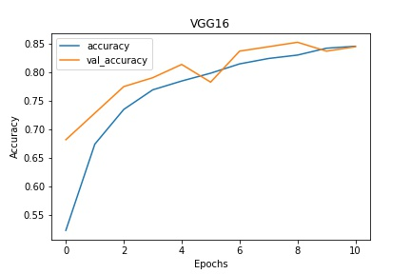
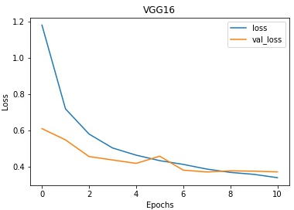
9. Model – CNN
Accuracy
85 %
Loss
Department of Computer Science & Engineering, MITSoE, Loni Kalbhor

Slide 20
References
[1] Iqra Kamran, Saeeda Naz, Imran Razzak, Muhammad Imran Handwriting dynamics assessment using deep neural network for early identification of Parkinson’s disease
[2] A. Parziale, R. Senatore, A. Della Cioppa, A. Marcelli Cartesian Genetic Programming for Diagnosis of Parkinson Disease through Handwriting Analysis: performance vs. interpretability issues
[3] Kalana R1, Leya Elizabeth Sunny Detection of Parkinson’s Disease Through Static Analysis of Handwriting and Character Recognition.
[4] Catherine Taleb1 · Laurence Likforman‐Sulem2 Detection of Parkinson’s disease from handwriting using deep learning: a comparative study.
[5] Mehrbakhsh Nilashi , Rabab Ali Abumalloh, Behrouz Minaei-Bidgoli, Sarminah Samad Predicting Parkinson’s Disease Progression: Evaluation of Ensemble Methods in Machine Learning.
Department of Computer Science & Engineering, MITSoE, Loni Kalbhor

Slide 21
Thank You
Department of Computer Science & Engineering, MITSoE, Loni Kalbhor

